Slide 1


DX University
Visalia California – 2012
Principal Sponsor

Slide 2
Propagation for Working DX
Carl Luetzelschwab K9LA

Slide 3
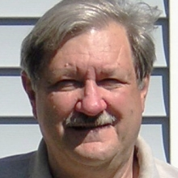
Carl Luetzelschwab K9LA
Carl Luetzelschwab K9LA was licensed as WN9AVT in October 1961. He upgraded to General in May 1962 and became WA9AVT. In 1977 he selected K9LA when the FCC offered 1 x 2 call signs to Extra Class licensees.
Carl enjoys propagation, DXing, contesting (he was the Editor of The National Contest Journal from 2002-2007), and antennas. He is an MSEE out of Purdue, and professionally he is an RF design engineer with Raytheon (formerly Magnavox).
Carl's primary expertise for DXU is propagation. Carl is a DXCC Card Checker with the ARRL, is at the Top of the Honor Roll, and enjoys viewing extremely old QSLs (especially from deleted entities).

Slide 4
Propagation for Working DX
I will cover five topics: the ionosphere, propagation predictions, interpreting space weather, short path vs long path, and the impact of the ionosphere on antenna height
Some additional items on the accompanying CD
  Presentation - SeaPac 2011 by K9LA “Radio Wave Propagation”
  Book - NM7M’s “The Little Pistol’s Guide to HF Propagation”
ON4UN’s “Low-Band DXing” 5th Edition
Visit http://myplace.frontier.com/~k9la
The NEW Short Wave Propagation Handbook (W3ASK-N4XX-K6GKU, CQ, 1995); Radio Amateurs Guide to the Ionosphere (McNamara, Krieger Publishing, 1994); Ionospheric Radio (Davies, Peter Peregrinus Ltd, 1990)

Slide 5
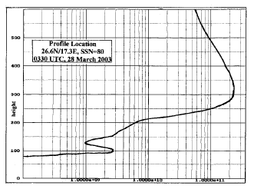
Propagation for Working DX – The Ionosphere
Ionosphere consists of three regions
  D region > 0.1 – 1 nm (hard X-rays) (responsible for daytime absorption)
  E region > 1 – 10 nm (soft X-rays)
  F region > 10 – 100 nm (EUV) (responsible for most DX QSOs)
Sunspots and 10.7 cm solar flux are proxies for solar ionizing radiation
Ionosphere varies
  Throughout the world
  Over a solar cycle – approx 11 years – high bands best at solar max (now)
  Seasonally
  Diurnally
nighttime
F2 peak
F1 inflection
valley
D inflection
E peak
Best to think of the ionosphere as regions, not layers (layer suggests thin shell)
See “Correlation Between Solar Flux and Sunspot Number” on CD
See “The Formation of the Ionosphere” on CD
See “Structure of the Ionosphere” on CD
See “Measuring the Ionosphere” on CD

Slide 6
Propagation for Working DX - Predictions
Our predictions are not daily predictions - why not?
  Because our models are monthly models
Let’s look at some specific data – August 2009
  10.7 cm solar flux constant, zero sunspots, A < 15
  MUF varied between 11 and 21 MHz
See “IRI 2007” on CD

Slide 7
Propagation for Working DX - Predictions
See “The Day-to-Day Variability of the Ionosphere” on CD
Day-to-day daytime variability of F region
  Solar ionizing radiation, solar wind/geomagnetic field activity, events in lower atmosphere coupling up to the ionosphere
Drove the developers to a monthly median model
  Correlation is between a smoothed solar index (smoothed sunspot number or smoothed 10.7 cm solar flux) and monthly median ionospheric parameters
  We have a model that is an “average” over a month’s time frame
    It doesn’t capture the daily short-term variations
    Using the daily sunspot number or daily 10.7 cm solar flux does not make the results more accurate
Two good free programs available
  VOACAP (VOA’s version of IONCAP)
  W6ELProp is more user friendly than VOACAP and has a nice mapping application (great circle paths and terminator)
See “VOACAP Tutorial” on CD
See “W6ELProp Tutorial” on CD
See “Correlation Between MUF and Solar Flux” on CD
See “Propagation Predictions: Their Development and Use” on CD

Slide 8
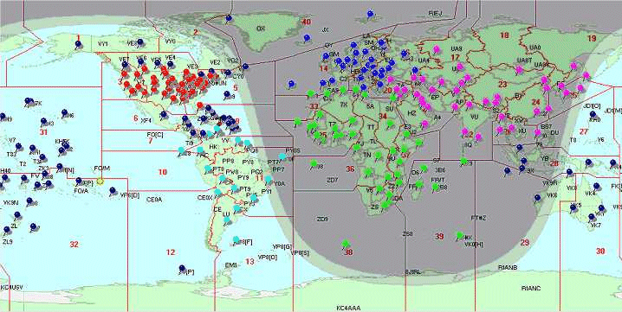
Propagation for Working DX - Predictions
If you don’t want to roll your own . . .
Use the predictions by N6BV
Over 240 locations worldwide
Over six phases of a solar cycle
Summary predictions to seven continental areas (EU, FE, SA, AF, AS, OC, NA) on 80m, 40m, 20m, 15m, 10m
Detailed predictions to all forty CQ zones on 160m – 10m
See “N6BV Predictions” on CD

Slide 9
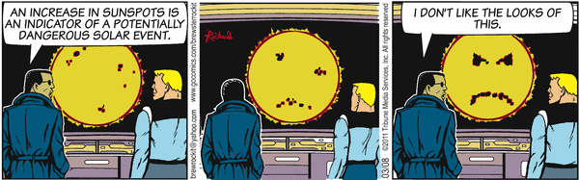
Propagation for Working DX – Space Weather
See “STORM Model” on CD
See “A Look Inside the Auroral Oval” on CD
See “D-Region Model” on CD
As seen earlier, space weather (solar ionizing radiation and solar wind/ geomagnetic field activity/electrodynamics) isn’t the only factor that determines the short-term variability of the ionosphere
The contribution by the neutral atmosphere makes it tough to directly correlate space weather to the short-term state of the ionosphere
I believe the best approach in using space weather is the following
  Get the “Big Picture” - Review solar flux/sunspot number/Ap index and determine if disturbances to propagation are in progress

Slide 10
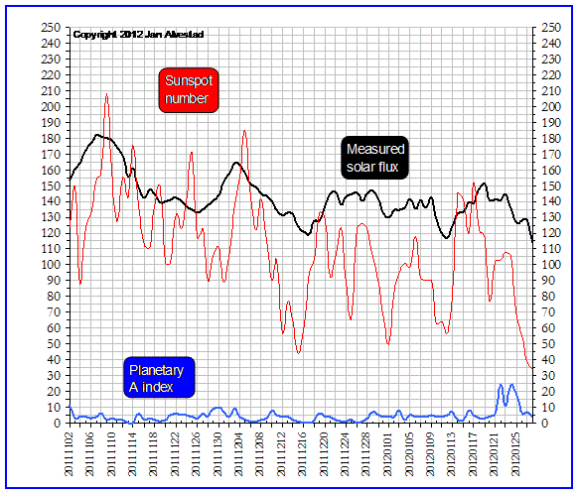
Propagation for Working DX – Space Weather
Needed long-term solar flux or sunspot number for F₂ openings
  6-Meters: SFI > 200 or ssn > 100
  10-Meters: SFI > 100 or ssn > 50
  12-Meters: SFI > 75 or ssn > 35
  15-Meters: SFI > 50 or ssn > 25
17-Meters and 20-Meters generally open throughout a solar cycle
  May be restricted to daylight hours
Low bands not dependent on MUF
Ap index less than 7 indicates quiet geomagnetic field
  Over the pole paths (high lat) the best
The Big Picture – SFI, SSN, Ap
http://www.solen.info/solar/

Slide 11
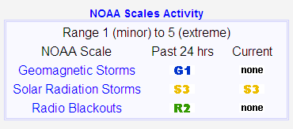
Propagation for Working DX – Space Weather
The Big Picture – Disturbances to Propagation
Review summary conditions at http://www.swpc.noaa.gov/
G = Geomagnetic storm - disturbance in the Earth’s magnetic field caused by gusts in the solar wind that blow by Earth (CMEs and coronal holes)
S = Solar radiation storm – disturbance in the polar cap due to increased levels of energetic protons
R = Radio blackout – disturbance on the daylight side of Earth due to increased electromagnetic radiation at X-ray wavelengths
Each is on a scale of 1 (minor) to 5 (extreme)
More details at http://www.swpc.noaa.gov/NOAAscales/
See “Disturbances to Propagation” on CD
See “Where Do the A and K Indices Come From?” on CD

Slide 12
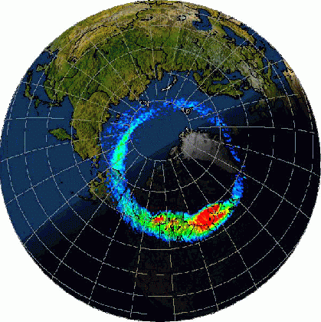
Propagation for Working DX – Space Weather
Disturbances to Propagation – A Visual Picture
2) Solar radiation storm (a.k.a. PCA) – increased D region absorption in the polar cap due to energetic protons from a big solar flare
1a) Geomagnetic storm – decreased F2 region MUFs at high and mid latitudes both day and night
X
North magnetic pole
3) Radio blackout – increased absorption on daylight side of Earth due to extremely short wavelength electromagnetic radiation from a big solar flare
1b) Geomagnetic storm – increased auroral ionization causing increased absorption and horizontal refraction (skewed path)
See “Impact of CMEs to Propagation” on CD
See “Impact of Solar Flares to Propagation” on CD

Slide 13
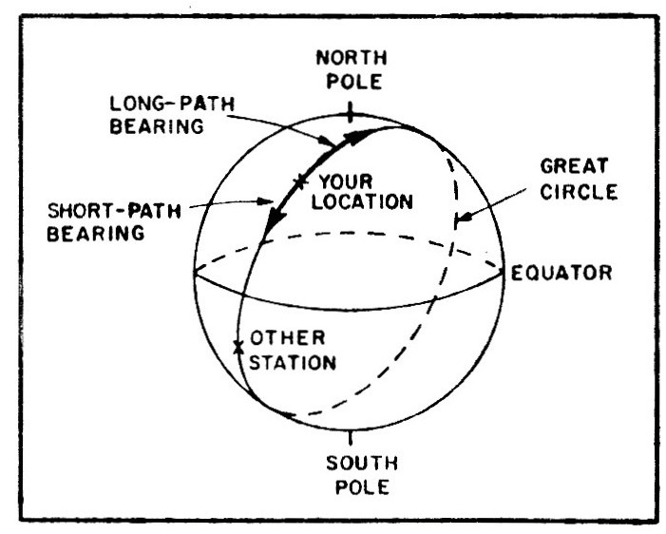
Propagation for Working DX – SP vs LP
An electromagnetic wave travels in a straight line unless it is refracted, reflected, or scattered
Shortest distance between any two points on a globe is a great circle path
  This is short path - Airliners fly short great circle paths to use the minimum amount of fuel
Other way around is long path
Location on opposite side of Earth to your location is called your antipode
  Short path and long path are equal – approx 20,000 km (12,500 miles)
ANTIPODE
See “Physics of Propagation” on CD
See “The M-Factor” on CD

Slide 14
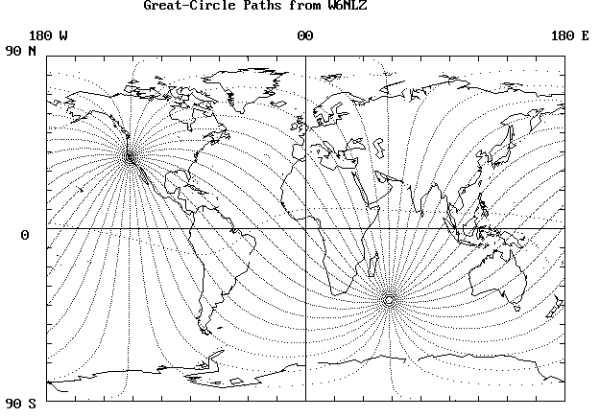
Propagation for Working DX – SP vs LP
For target locations near antipode, may see several paths
Lower bands – long path usually offers the least absorption (dark ionosphere)
Higher bands – long path usually offers the most ionization (daytime ionosphere)
Add gcp map centered on W6
W6
W6 antipode
When you run propagation predictions or look at W6ELProp’s map to a target location, check long path in addition to short path

Slide 15
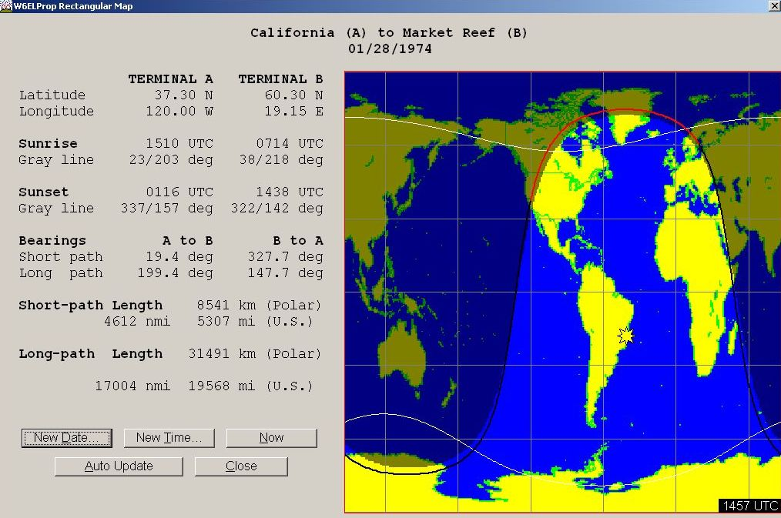
Propagation for Working DX – SP vs LP
W6 to EU on 75-Meter LP
Generally occurs from November thru March
Around W6 sunrise
Good signal strengths without high power levels and without big antennas
Example shown is classical “gray line” propagation
See “The Gray Line Method of DXing” on CD

Slide 16
Propagation for Working DX – SP vs LP
10-Meter LP for North America
For W6, evening long path to EU is probably most productive
See “10-Meter Long Path” on CD

Slide 17
Propagation for Working DX – Antennas
Purpose of an antenna is to put the most energy
  at the required azimuth angle (N, NE, E, etc)
  at the required elevation angle (10º, 20º, etc)
  with the required polarization (horizontal, vertical, circular)
The ionosphere dictates these three parameters – not the antenna
Most of the time a great circle path is dictated – azimuth determined by locations on globe
At HF, circular polarization is predominant
  Horizontal or vertical equally good - only down 3 dB
  But vertical antenna picks up more man-made noise and is more ground dependent
See “Polarization” on CD

Slide 18
Propagation for Working DX - Antennas
Elevation angles required on 10-Meters for Indianapolis
N6BV data on the CD-ROM in the 2012 ARRL Antenna Book (22nd Edition)
Indianapolis to the world by continent (including USA) on 10-Meters

Slide 19
Propagation for Working DX - Antennas
Antenna elevation patterns
5-element HyGain monobander over average ground

Slide 20
Propagation for Working DX - Antennas
Superimpose required elevation angles on antenna patterns
See “Best Height for 10-Meter Antenna” on CD
25 ft (red) – doesn’t cover the low angles (< 10º) very well
100 ft black) – covers the low angles, but has two gaps at 10º and 20º
50 ft (blue) – probably the best height overall >> 1.5 λ

Slide 21
Propagation for Working DX - Antennas
You can go through this exercise on the other bands
Kind of tough to achieve low angle radiation on the lower bands
Best overall height for a single antenna appears to be 1.5 λ
  50 feet on 10-Meters 60 feet on 12-Meters
  70 feet on 15-Meters 80 feet on 17-Meters
  100 feet on 20-Meters 200 feet on 40-Meters
To cover all the elevation angles, need to stack several antennas
  For example, a three-high stack on 10-Meters: 25 feet, 50 feet, 100 feet

